Slide 1
Neural Network Regularization Norm Penalties and Early Stopping

Slide 3
Outline
Regularization of NN
Norm Penalties
Early Stopping
Data Augmentation
Dropout

Slide 4
Regularization
Regularization is any modification we make to a learning algorithm that is intended to reduce its generalization error but not its training error.

Slide 5
Outline
Regularization of NN
Norm Penalties
Early Stopping
Data Augmentation
Dropout

Slide 6
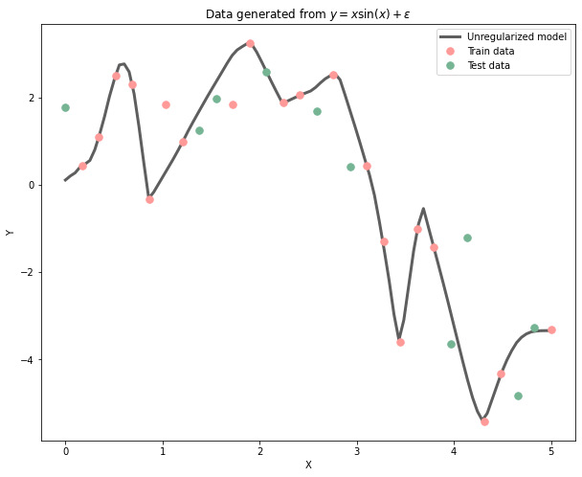
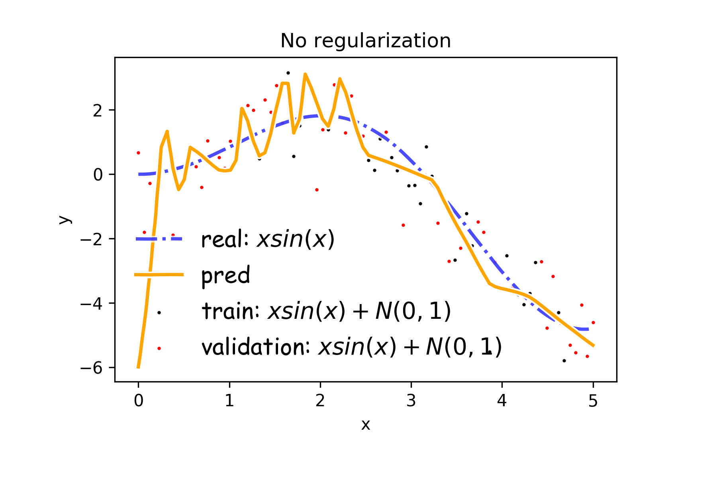
Overfitting
Fitting a deep neural network with 5 layers and 100 neurons per layer can lead to a very good prediction on the training set but poor prediction on validations set.

Slide 7
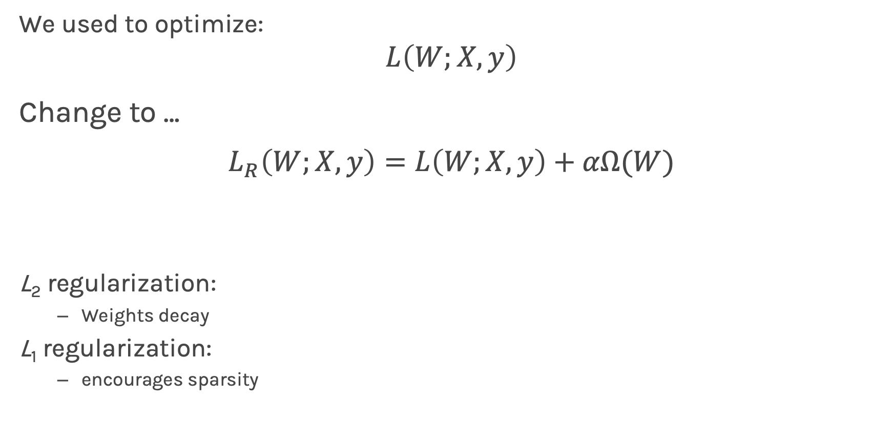
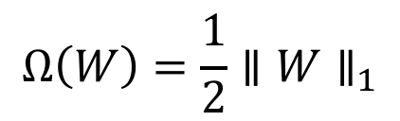
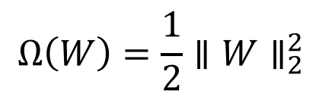
Norm Penalties
We used to optimize:
$$L\left(W;X, y\right)$$
Change to …
$$L_{R}\left(W;X,y\right)=L\left(W;X, y\right)+αΩ(W)$$
L₂ regularization:
Weights decay
L₁ regularization:
encourages sparsity
Biases could be penalized
$$Ω\left(W\right)=\frac{1}{2}∥W∥_{2}^{2}$$
$$Ω\left(W\right)=\frac{1}{2}∥W∥_{1}$$

Slide 8
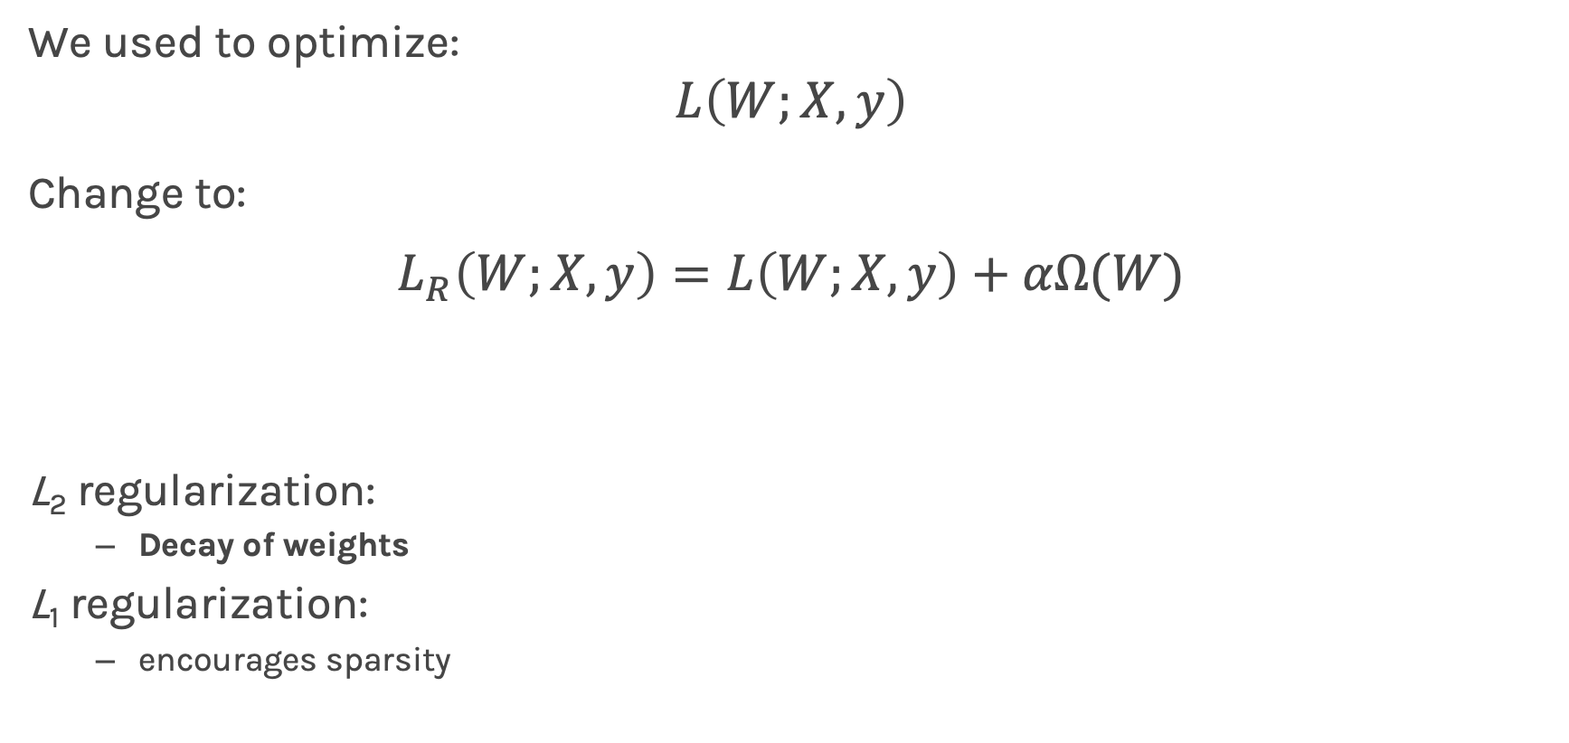
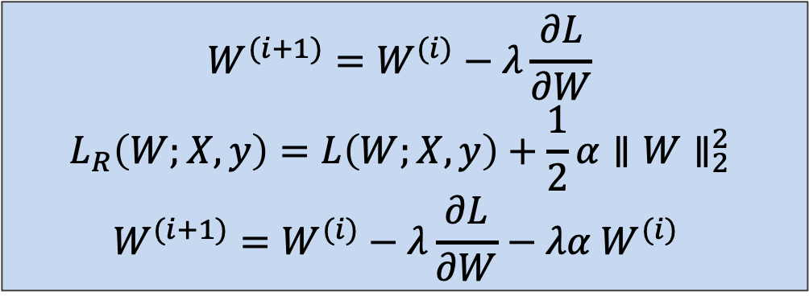
Norm Penalties
Weights decay in proportion to size
We used to optimize:
$$L\left(W;X, y\right)$$
Change to:
$$L_{R}\left(W;X,y\right)=L\left(W;X, y\right)+αΩ(W)$$
L₂ regularization:
Decay of weights
L₁ regularization:
encourages sparsity
$$W^{(i+1)}=W^{(i)}−λ\frac{∂L}{∂W} \\ L_{R}\left(W;X,y\right)=L\left(W;X, y\right)+\frac{1}{2}α∥W∥_{2}^{2} \\ W^{(i+1)}=W^{(i)}−λ\frac{∂L}{∂W}−λα W^{(i)}$$
Biases could be penalized
$$Ω\left(W\right)=\frac{1}{2}∥W∥_{2}^{2}$$
$$Ω\left(W\right)=\frac{1}{2}∥W∥_{1}$$

Slide 9
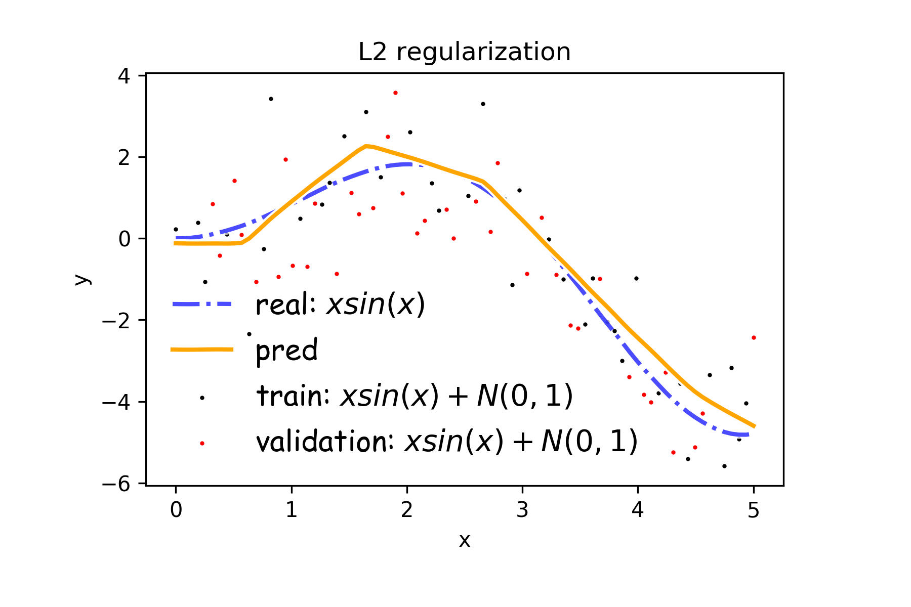
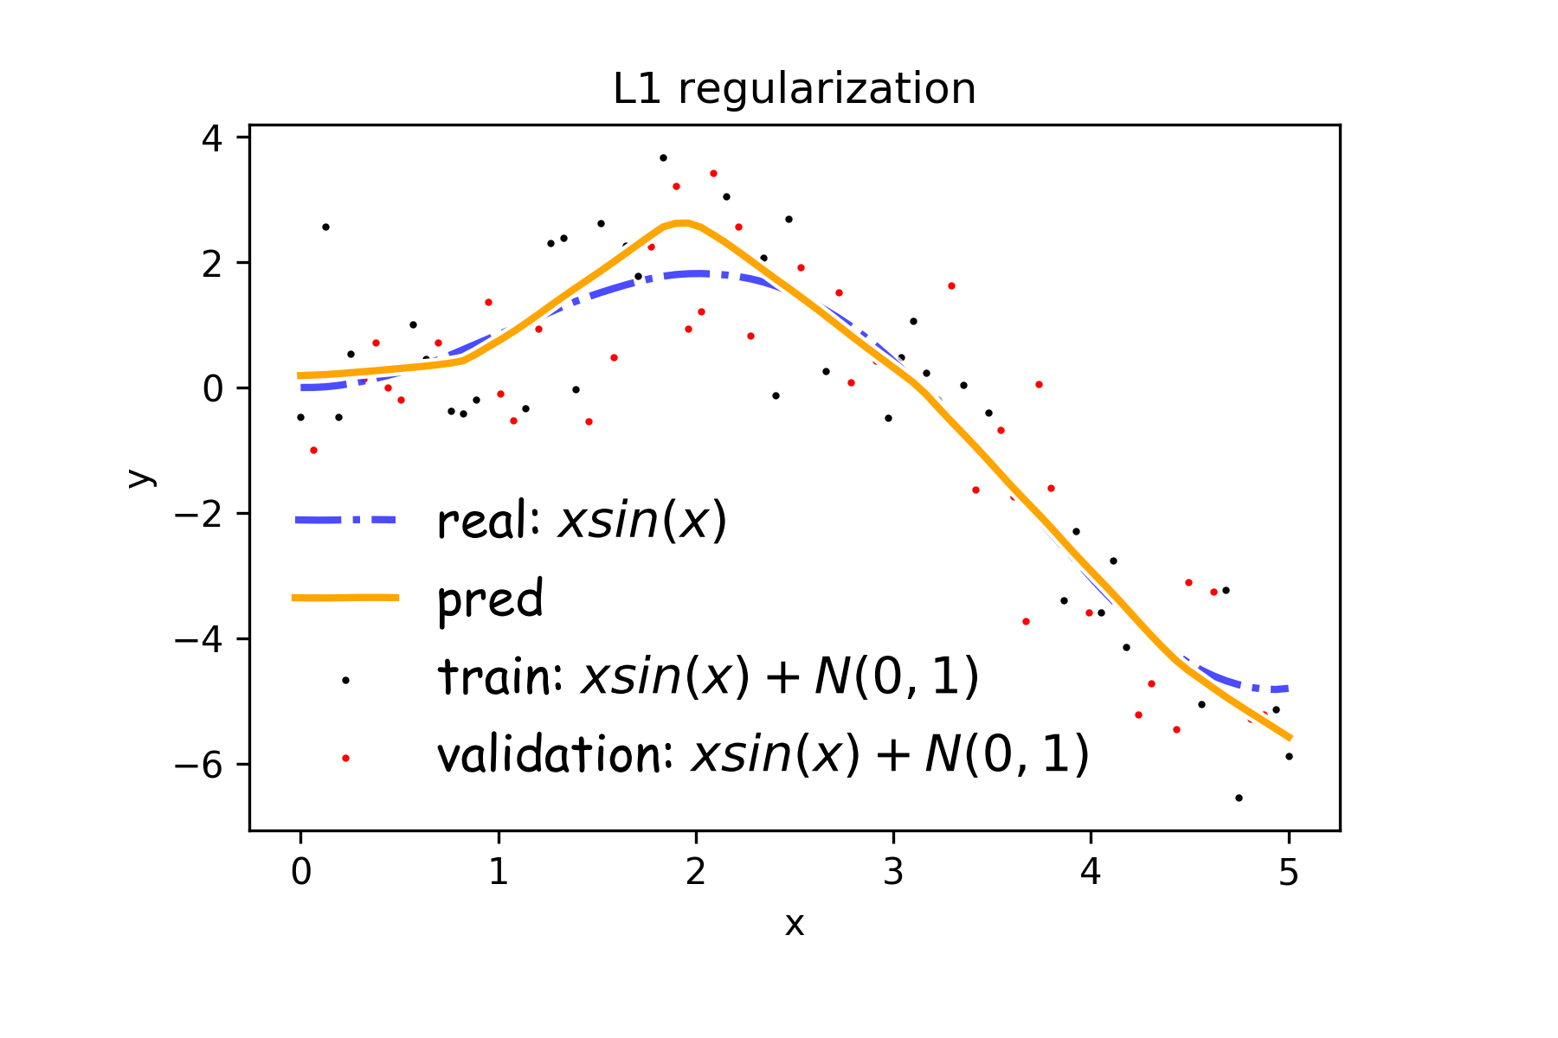
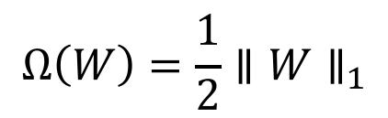
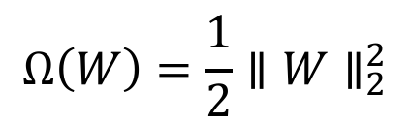
Norm Penalties
$$Ω\left(W\right)=\frac{1}{2}∥W∥_{2}^{2}$$
$$Ω\left(W\right)=\frac{1}{2}∥W∥_{1}$$

Slide 10
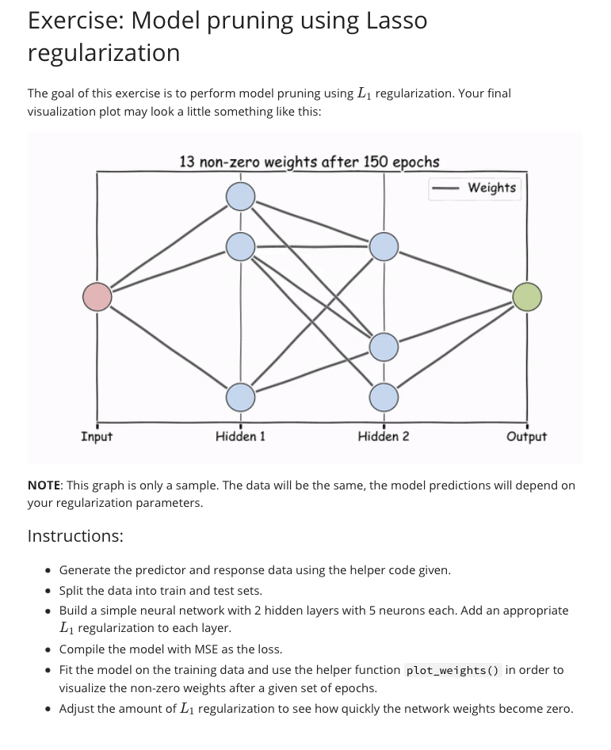
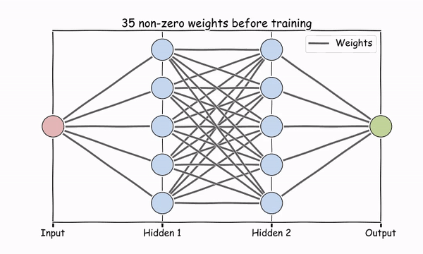

Slide 11
Outline
Regularization of NN
Norm Penalties
Early Stopping
Data Augmentation
Dropout

Slide 12
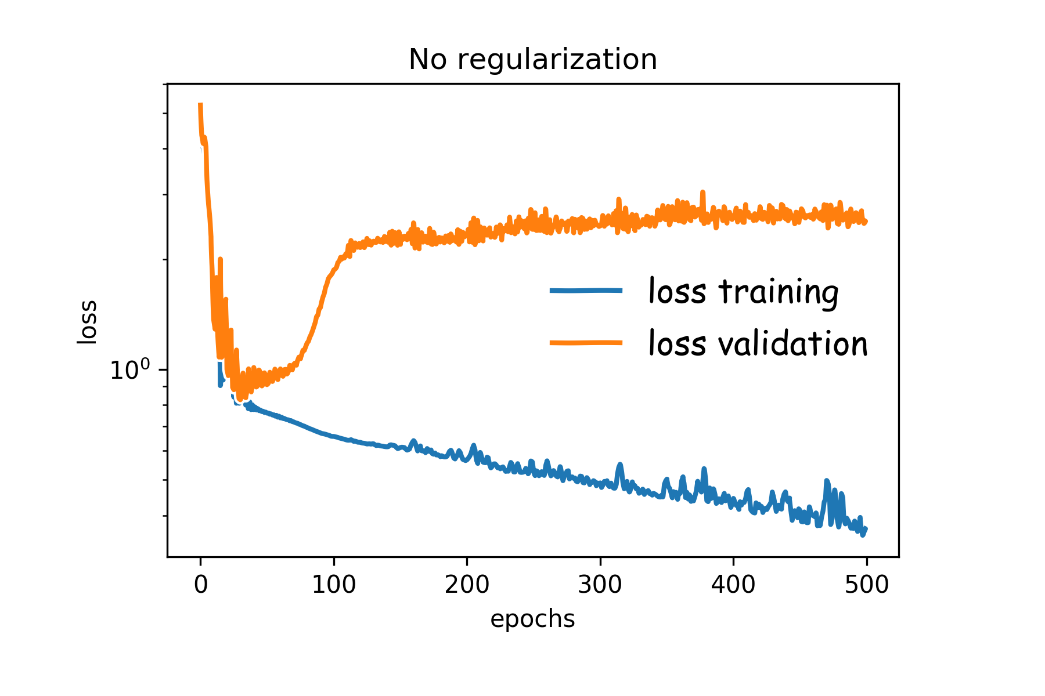
Early Stopping
Early stopping: terminate while validation set performance is better. Sometimes is worth waiting a little before stopping. This is called patience.
Patience is defined as the number of epochs to wait before early stop if no progress on the validation set.
The patience is often set somewhere between 10 and 100 (10 or 20 is more common), but it really depends on the dataset and network.

Slide 14
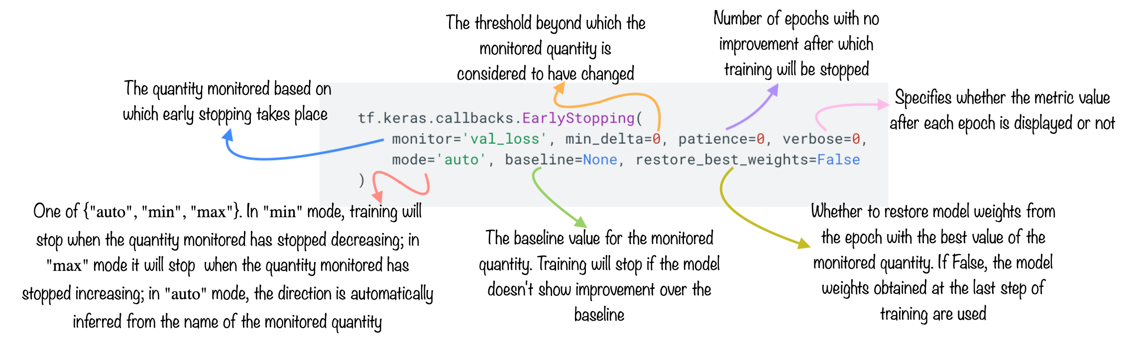

Slide 15
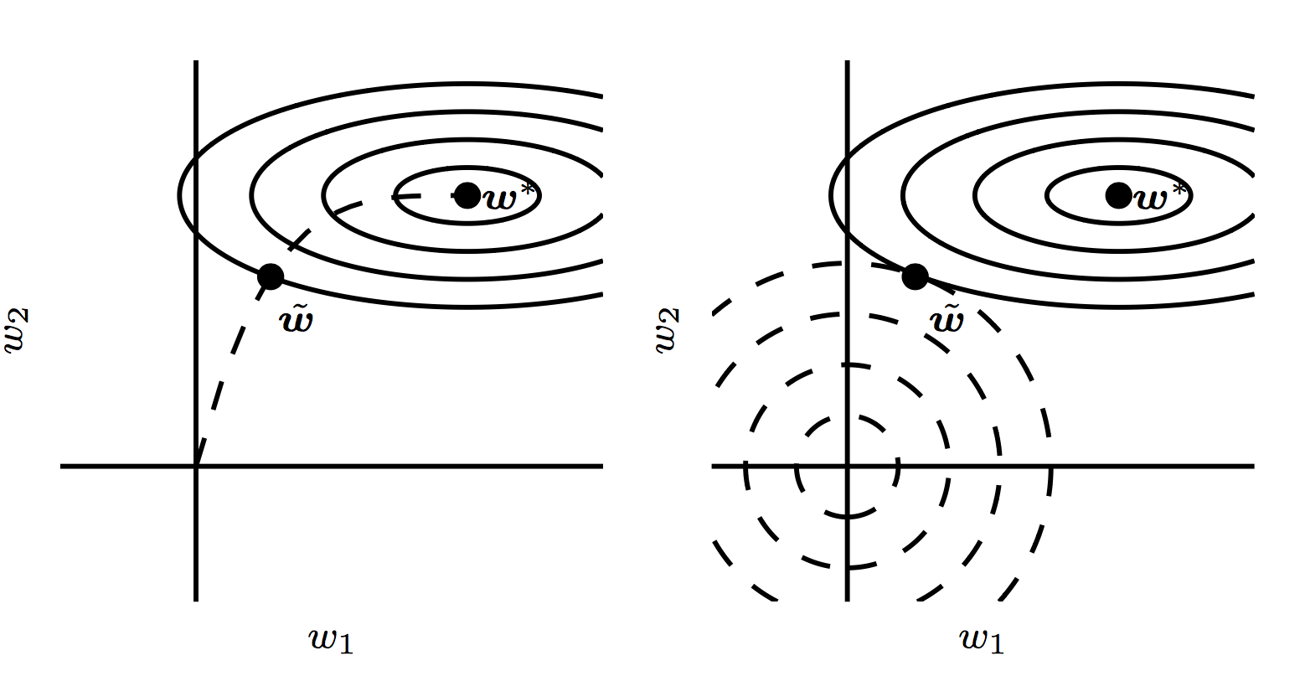
Early Stopping

Slide 16
Exercise: Model Pruning
The goal of this exercise is to perform model pruning using L1 regularization
Build a simple neural network with 2 hidden layers
Compile the model and train it for a few epochs
Use the helper code given to visualize the model pruning

Slide 17
Exercise: Early stopping
The goal of this exercise is to perform early stopping
Build a neural network with 5 hidden layers and 100 neurons each
Use the 'early stopping' callback in model training
Compare the test MSE of the unregularized model with the model trained with early stopping

